Slide 1

Secure LAN Chat Using AES Encryption
Benedict Joshua M,
Priyadarsan A
Class Section (III AI & DS A)
2024-2028 Batch

Slide 2
CONTENTS
Problem Statement
Objectives
Requirement Specification
System Design
Results
Conclusion

Slide 3
Problem Statement
Traditional LAN-based chat applications may transmit messages in plain text, making sensitive information vulnerable to unauthorized access or network monitoring. There is a need for a simple and secure communication system that protects messages before they are transmitted over a local network. This project addresses the problem by developing a web-based LAN chat application that uses AES encryption to encrypt messages on the sender’s side and decrypt them only at the receiver’s side, while the server forwards only the encrypted data.

Slide 4
Objectives
Develop a web-based secure chat application for LAN communication.
Encrypt messages using the AES encryption algorithm before transmission.
Transmit only encrypted data through the Node.js server.
Decrypt messages at the receiver’s side using the shared secret key.
Demonstrate secure and real-time communication using Socket.IO.
Provide delivery confirmation to the sender after successful message delivery.
Prevent the server from directly accessing the plaintext message.

Slide 5
Requirement Specification
Hardware Requirements
Laptop/PC with minimum 4 GB RAM
Smartphone or second computer for Client B
Wi-Fi router or mobile hotspot
Network connectivity between devices
Software Requirements
Operating System: Windows / Linux / macOS
IDE: Visual Studio Code
Runtime: Node.js
Frontend: HTML, CSS, JavaScript
Backend: Express.js, Socket.IO
Encryption Library: CryptoJS
Browser: Google Chrome / Microsoft Edge
Dataset Specification
Dataset: Not required
Uses user-entered text messages as input
Messages are encrypted using AES before transmission
No external or pre-existing dataset is used

Slide 6
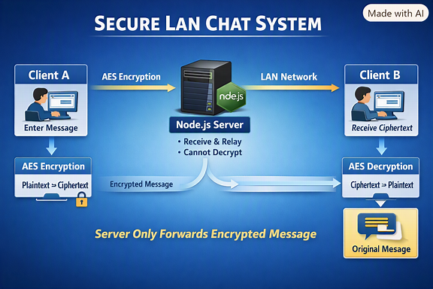
System Design

Slide 7
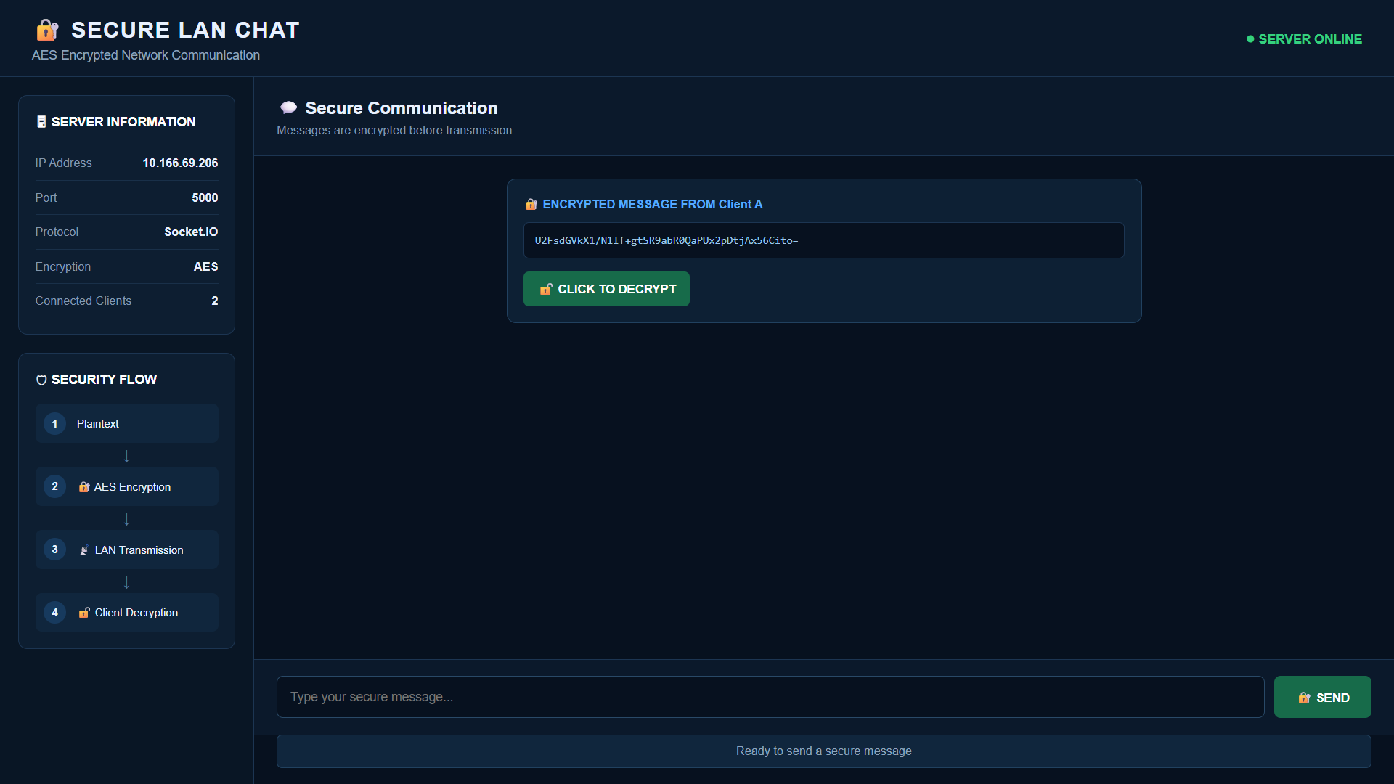
Results
Successfully established communication between Client A and Client B over LAN.
Encrypted messages using the AES algorithm before transmission.
Displayed ciphertext at the receiving client.
Successfully decrypted the message using the shared secret key.
Provided delivery confirmation to the sender.
Demonstrated that the server forwards encrypted data without reading the plaintext.
Figure 1: Secure LAN Chat showing AES-encrypted message transmission and successful decryption.

Slide 8
Conclusion
Developed a web-based Secure LAN Chat application for real-time communication.
Implemented AES encryption to protect messages before network transmission.
Established real-time client communication using Node.js, Express.js, and Socket.IO.
Enabled the receiver to decrypt encrypted messages using the shared secret key.
Ensured that the server forwards ciphertext without directly accessing plaintext.
Demonstrated secure message delivery between two LAN-connected clients.
Successfully achieved the objective of combining computer networking with basic data security.

Slide 9
Thank You

